Slide 1
Heart Disease Predictive Model
Brian Bell

Slide 2
Introduction
Heart Disease is leading cause of death
25% of deaths in USA
Screening is critical
Patient Compliance is a challenge

Slide 3
Opportunity
Digital patient records present opportunities
Use patient data to train a classifier
Flag patients at high risk
Provide targeted additional screening

Slide 4
Data Acquisition
Data from UCI Machine Learning Repository
http://archive.ics.uci.edu/ml/datasets/Heart+Disease

Slide 5
Data Wrangling
Replace 0s and ?s with NaN
Missing data in CA, Thal

Slide 6
Data Wrangling
Split Categorical Data with OneHotEncoder
Fill NaN with KNN imputation
Standardize Numerical data to a 0-1 range

Slide 7
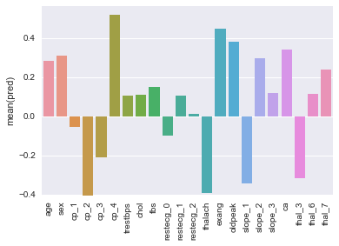
Data Exploration
Correlation Coefficients with Predicted Attribute

Slide 8
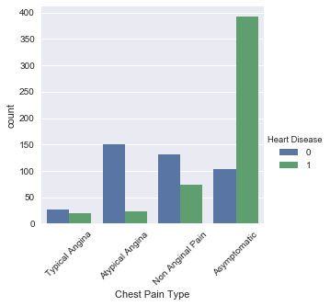
One Small Problem
Highest correlation with heart disease is cp_4
Cp_4 represents no chest pain

Slide 9
Sample Bias
Dataset is only of heart disease patients
Heart Disease heavily oversampled
  11.7% of population has heart disease
  55% of dataset has heart disease
Need general population data for screening

Slide 10
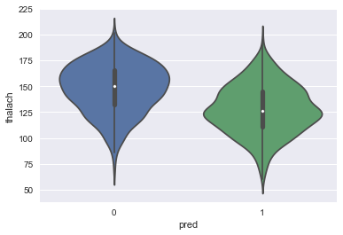
Typical Feature Behavior
Thalach: heartrate achieved on stress test

Slide 11
Model Selection
Logistic Regression
  Goal is classification
  Decision boundary should be linearly separable
  Handles mix of numerical/categorical well

Slide 12
Model Implementation
Introduce squares of numerical data
  25-30 years old less significant than 65-70
30% of data set aside for testing
GridsearchCV for best regularization parameter

Slide 13
Results
Cp_4 is erroneously a strong predictor
All of restecg is negative

Slide 14
Test Categories
Separated tests by type
  basic vitals, rest ecg, routine labwork, stress ecg, thallium stress test, and cardiac catheterization

Slide 15
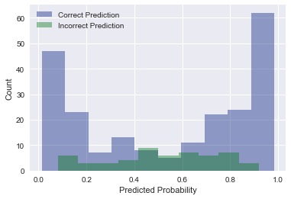
My Favorite Graph

Slide 16
Recommendations
Run patient records through model
Customize model based on available data
Target high risk patients
  Subsidized advanced diagnostics
  Notify doctors to advise patients

Slide 17
Improvements
Needs general population data
Research Advanced Diagnostics
  Which tests explain the most uncertainty

